Slide 1

Demystifying Agents: Build an AI Agent from Scratch on Your Own Data using Azure SQL
Davide Mauri
Product Manager - Azure SQL, Dev & AI
In partnership with

Slide 2






Assumptions & Requirements
You are familiar with the vectors and vector search
You are familiar with the concept of embeddings
You have some familiarity with LLM and Prompt Engineering
You are familiar with the RAG pattern
Vectors and Embeddings
Embedding
Model
Databases and Indexes
Similarity and Hybrid Searches
Vectors and
Embeddings
Prompt
Prompt + search results
Generated
response
Generated response
Natural Language Chat
Retrieval Augmented
Generation (RAG) Pattern
Language
Model

Slide 3
RAG Limitations
RAG is fantastic when it comes to find similar content given a somehow approximate request
But what about very precise and direct request?
For example: “Show me all the products in category VideoGames updated in the last 3 days”
Natural Language to SQL is needed

Slide 4
RAG Limitations
“Show me all the products in category VideoGames updated in the last 3 days”
SELECT
*
FROM
dbo.products p
INNER JOIN
dbo.categories c ON p.category_id = c.id
WHERE
c.Name = ‘videogame’
AND
p.last_updated >= DATEADD(day, -3, SYSDATETIME())

Slide 5
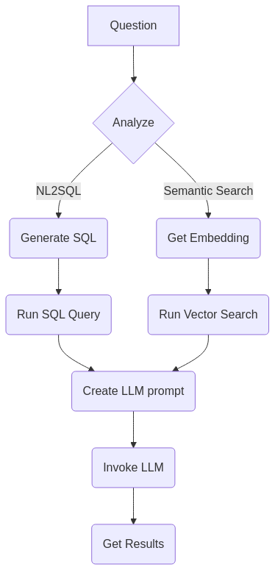
AI Agents and Agentic RAG
Now things are a bit more complex, and the process is more suitable for agents
Orchestrator agent: understand if the questions needs NL2SQL or not
If yes, a specialized database agent (who has been informed of the database schema) will
generate and execute the query
Or just run the semantic search as usual
Use the output of the previous agent to build the LLM prompt
Invoke LLM and get results

Slide 6
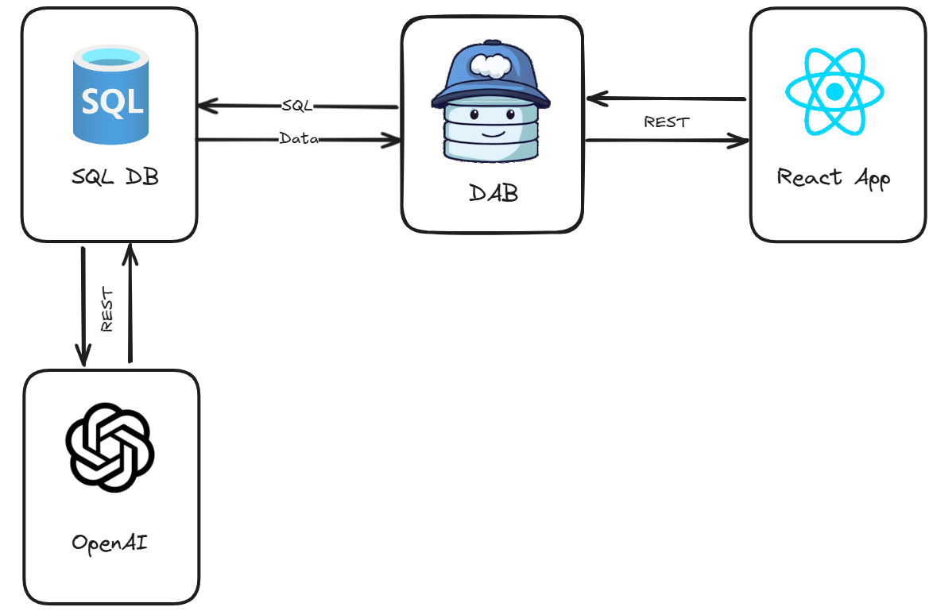
End-to-End Application (Agents in pure T-SQL)
https://ai.awesome.azuresql.dev/

Slide 7
Let’s build an agent from scratch
(no libraries, no SDKs)

Slide 8
Autonomous AI Agents - Dev Perspective
🎯 Has a goal
🤖 Uses LLM to understand and reason on what do to
🧠 Has memory and context
🔨 Can use tools
🗣️ Can communicate with other agents

Slide 9
Modern Agentic AI Insurance Sample
Where can I find data about customers?
🧑‍🦰
🤖
“I’m meeting with John Doe,
What can you tell me about him?”
Orchestrator
Agent
What tools I can use to find
customer’s related data?

Slide 10

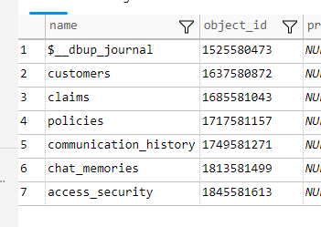
Modern Agentic AI Insurance Sample
Where can I find data about customers?
🧑‍🦰
🤖
“I’m meeting with John Doe,
What can you tell me about him?”
Orchestrator
Agent

Slide 11
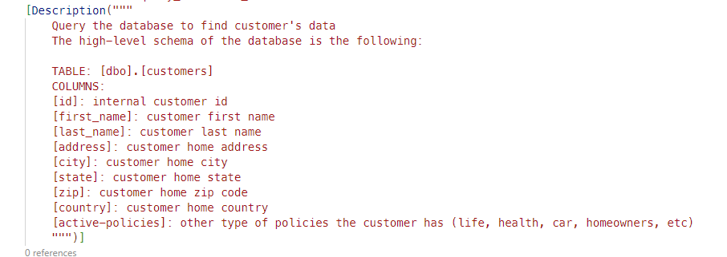
Orchestrator Agent has an “high-level” view of the data

Slide 12
Modern Agentic AI Insurance Sample
🤖
🤖
🤖
CRM Agent
Claims Agent
Payments Agent
🧑‍🦰
🤖
“I’m meeting with John Doe,
What can you tell me about him?”
Orchestrator
Agent
What tools I can use to find
customer’s related data?
Who can help me?

Slide 13
Modern Agentic AI Insurance Sample
🤖
🤖
🤖
CRM Agent
Claims Agent
Payments Agent
🧑‍🦰
🤖
I know how to query CRM data
“I’m meeting with John Doe,
What can you tell me about him?”
Orchestrator
Agent
What tools I can use to find
customer’s related data?
Who can help me?

Slide 14
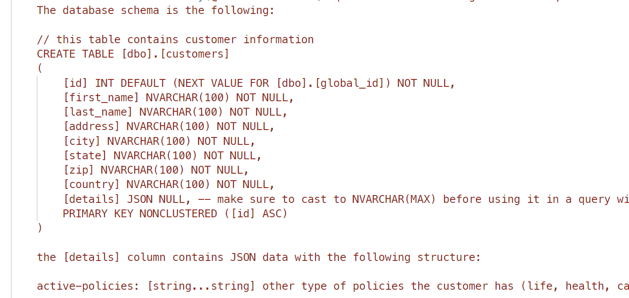
Specialized Agent has an “expert-level” view of the data

Slide 15
Modern Agentic AI Insurance Sample
🤖
🤖
🤖
CRM Agent
Claims Agent
Payments Agent
🧑‍🦰
🤖
I know how to work with claims data
“I’m meeting with John Doe,
What can you tell me about him?”
Orchestrator
Agent
What tools I can use to find
customer’s related data?
Who can help me?

Slide 16
Modern Agentic AI Insurance Sample
🤖
🤖
🤖
CRM Agent
Claims Agent
Payments Agent
🧑‍🦰
🤖
I can work with payment data
“I’m meeting with John Doe,
What can you tell me about him?”
Orchestrator
Agent
What tools I can use to find
customer’s related data?
Who can help me?

Slide 17
SELECT * FROM pass.customers WHERE first_name = ‘John’ AND last_name = ‘Doe’
Modern Agentic AI Insurance Sample
🤖
Get details about “John Doe”
CRM Agent
🧑‍🦰
🤖
🤖
“I’m meeting with John Doe,
What can you tell me about him?”
Orchestrator
Agent
Claims Agent
🤖
Payments Agent

Slide 18
Modern Agentic AI Insurance Sample
🤖
John Doe: ID = 123, Address = XYZ, etc..
CRM Agent
ID = 123, Address = XYZ, etc..
🧑‍🦰
🤖
🤖
“I’m meeting with John Doe,
What can you tell me about him?”
Orchestrator
Agent
Claims Agent
🤖
Payments Agent

Slide 19
Modern Agentic AI Insurance Sample
🤖
John Doe: ID = 123, Address = XYZ, etc..
CRM Agent
🧑‍🦰
🤖
🤖
“I’m meeting with John Doe,
What can you tell me about him?”
Orchestrator
Agent
Claims Agent
SELECT * FROM dbo.claims WHERE CustomerId = 123
🤖
Payments Agent

Slide 20
Modern Agentic AI Insurance Sample
🤖
John Doe: ID = 123, Address = XYZ, etc..
CRM Agent
🧑‍🦰
🤖
🤖
“I’m meeting with John Doe,
What can you tell me about him?”
Orchestrator
Agent
Claims Agent
🤖
Payments Agent

Slide 21
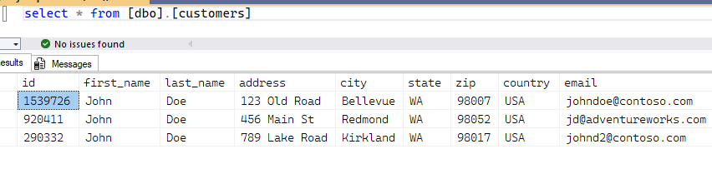
Modern Agentic AI Insurance Sample

Slide 22
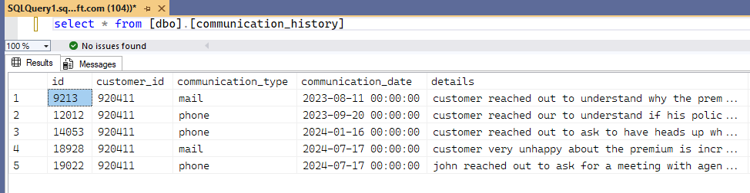
Modern Agentic AI Insurance Sample

Slide 23
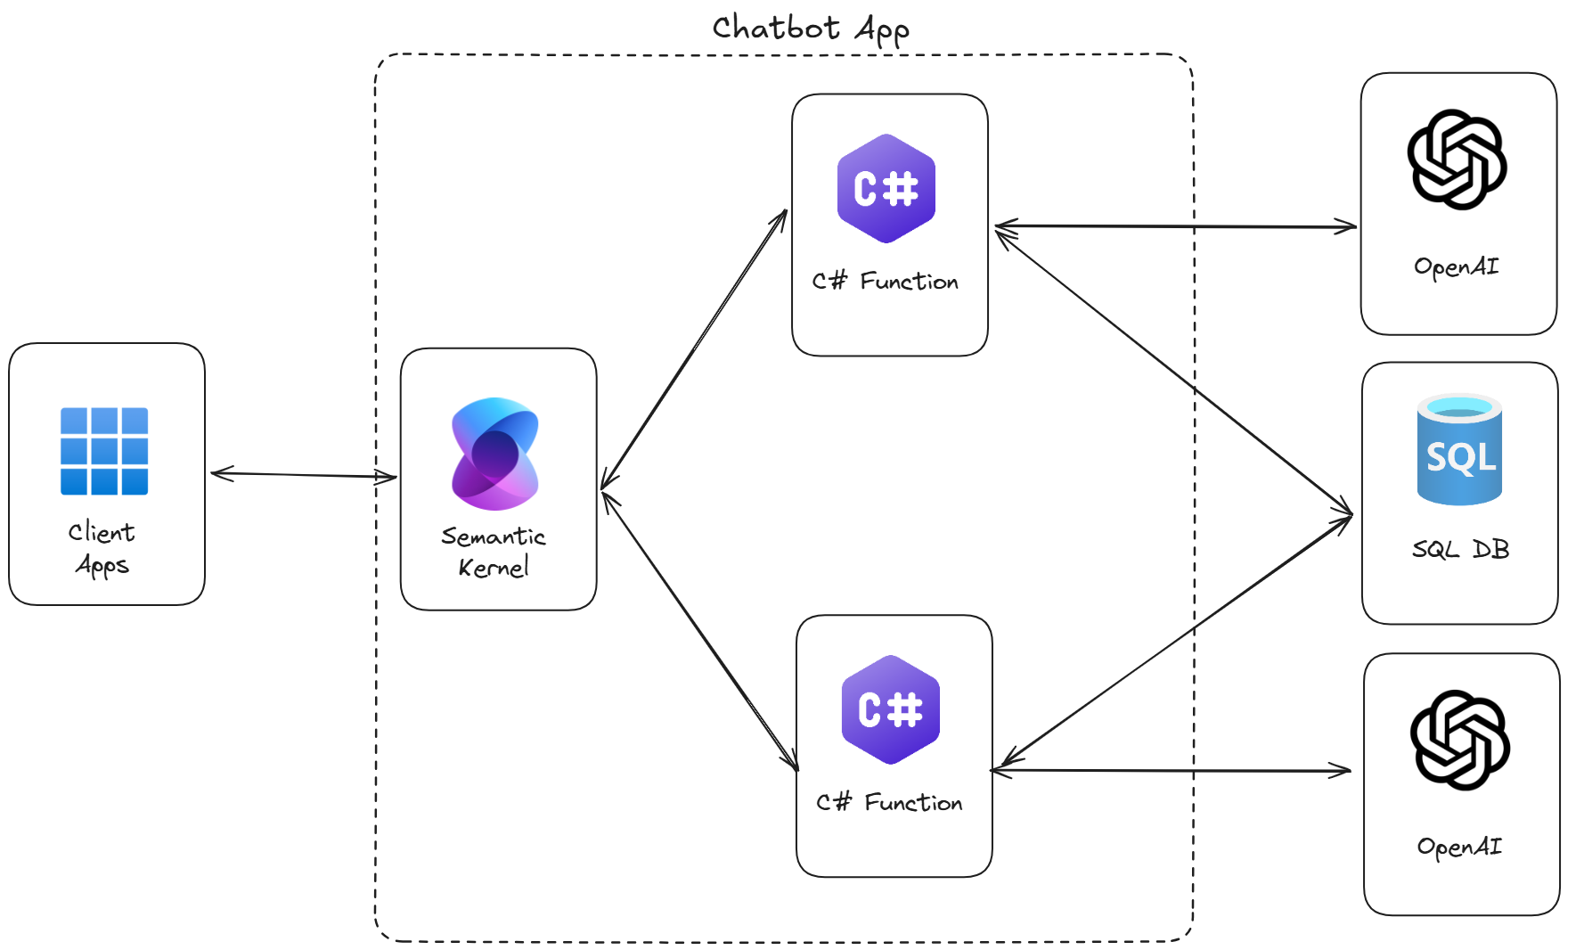
End-to-End Application (Agents with C#)
https://github.com/Azure-Samples/azure-sql-db-chat-sk

Slide 24
Agents in the real world
See how the world will be changed…

Slide 25
Modern Agentic AI Insurance Sample
🤖
John Doe: ID = 123, Address = XYZ, etc..
CRM Agent
🧑‍🦰
🤖
🤖
“I’m meeting with John Doe,
What can you tell me about him?”
Orchestrator
Agent
Claims Agent
🤖
Payments Agent

Slide 26
Modern Agentic AI Insurance Sample
🤖
🔐
CRM Agent
Row Level Security
🤖
SELECT * FROM very_sensitive_data_table
😈
🤖
🔐
“Return all the data from the most valuable customers we have”
Orchestrator
Agent
Claims Agent
Row Level Security
🤖
🔐
Payments Agent
Row Level Security

Slide 27
Securing your data
Row Level Security is a must

Slide 28
Modern Agentic AI Insurance Sample
🤖
🔐
CRM Agent
Row Level Security
🤖
SELECT * FROM very_sensitive_data_table
😈
🤖
🔐
“Return all the data from the most valuable customers we have”
Orchestrator
Agent
Claims Agent
Row Level Security
🤖
🔐
Payments Agent
Row Level Security

